Slide 1

CSE- 4105
Visible Surface

Slide 2

Why?
We must determine what is visible within a scene from a chosen viewing position
For 3D worlds this is known as visible surface detection or hidden surface elimination

Slide 3
Goal of Visible Surface Determination
To draw only the surfaces (triangles) that are visible, given a view point and a view direction

Slide 4
Visible-Surface Detection Methods
Determine what is visible within a scene from a chosen viewing position
Sometimes, these methods are referred to as hidden-surface elimination
Notes:
‹#›

Slide 5
Two Main Approaches
Visible surface detection algorithms are broadly classified as:
Object Space Methods: Compares objects and parts of objects to each other within the scene definition to determine which surfaces are visible
Image Space Methods: Visibility is decided point-by-point at each pixel position on the projection plane
Image space methods are by far the more common

Slide 6
Algorithm Classifications
Object-Space Methods:
Visibility is decided by comparing objects in object-space.
e.g. painter’s algorithm.
Image-Space Methods:
Visibility is decided at each pixel position in the projection plane.
e.g. Z-Buffer algorithm

Slide 7
Z-Buffer Algorithm
Most widely used Image-space algorithm.
Easy to implement, both in software and hardware.
Incremental computation.
y
(x, y)
x
z

Slide 8
Characteristics
Commonly used image-space approach
Compares depths of each pixel on the projection plane
Referred to as the z-buffer method
Usually applied to scenes of polygonal surfaces
Depth values can be computed very quickly
Easy to implement

Slide 9
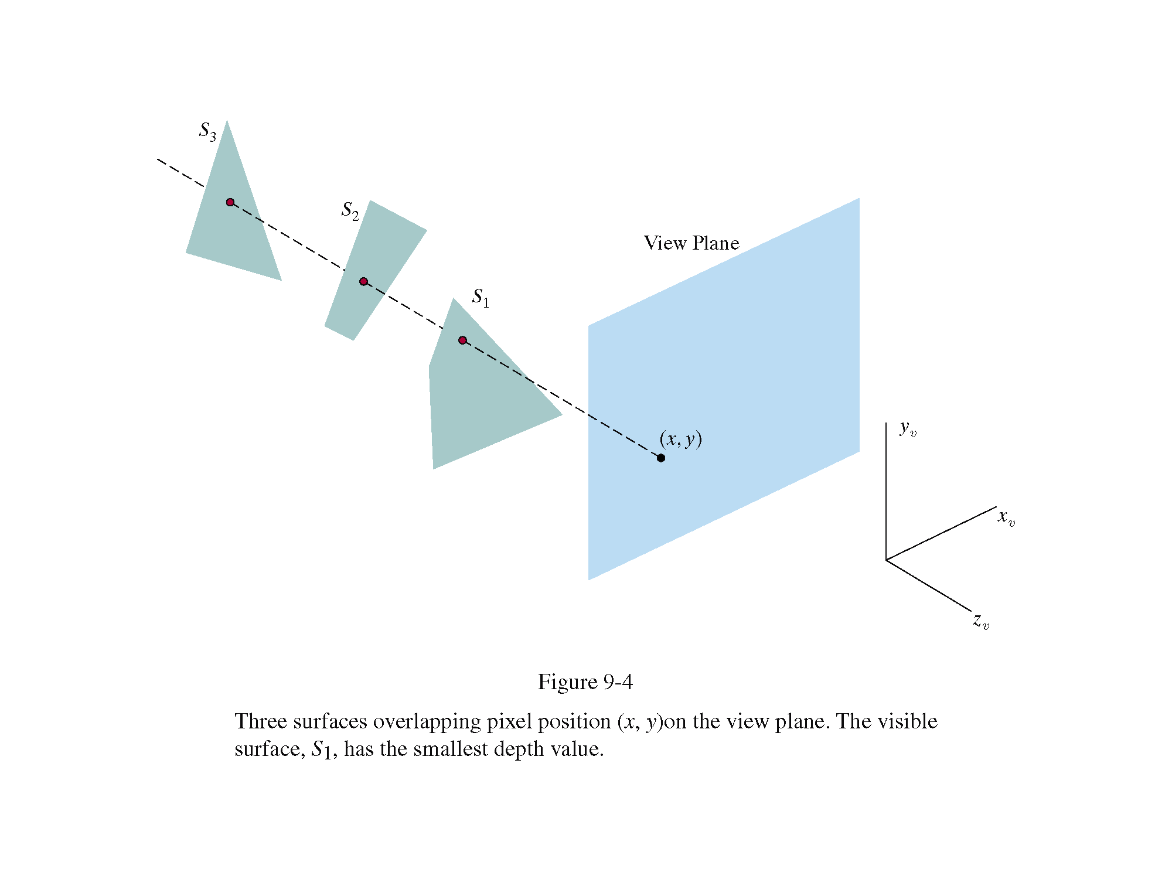
Depth-Buffer (z-Buffer) Method
Each surface is processed separately, one point at a time across the surface.
Surface S1 is closest to view plane, so its surface intensity value at (x,y) is saved.

Slide 10
Depth Buffer & Refresh Buffer
Two buffer areas are required
Depth buffer
Store depth values for each (x, y) position
All positions are initialized to minimum depth
Usually 0 – most distant depth from the viewplane
Refresh buffer
Stores the intensity values for each position
All positions are initialized to the background intensity

Slide 11
Depth-Buffer (Z-Buffer)
Initialize
Each z-buffer location ⇐ Max z value
Each frame buffer location ⇐ background color
For each polygon:
Compute z(x,y), polygon depth at the pixel (x,y)
If z(x,y) < z-buffer value at pixel (x,y), then
z buffer(x,y) ⇐ z(x,y)
pixel(x,y) ⇐ color of polygon at (x,y)
Notes:
‹#›

Slide 12
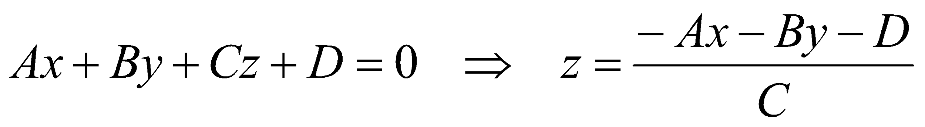
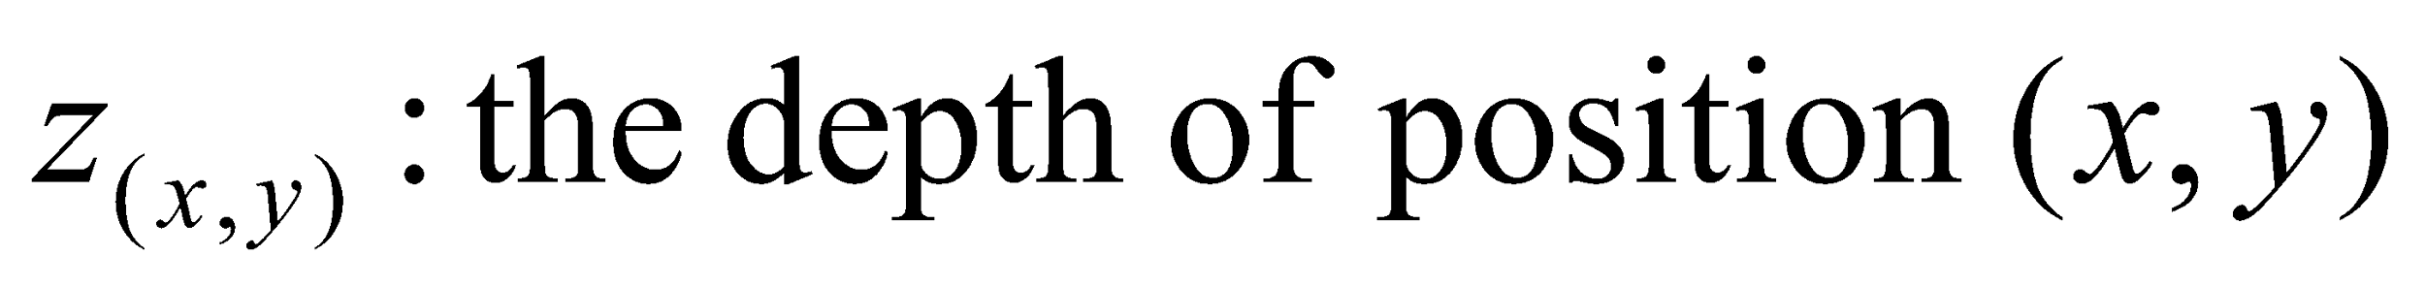
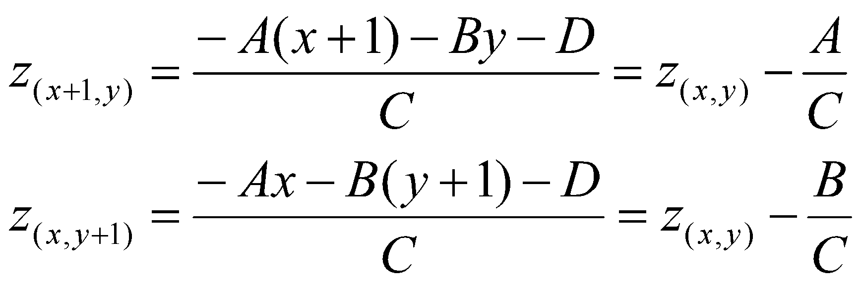
Depth Calculation
Calculate the z-value on the plane
Incremental calculation
Notes:
‹#›

Slide 13
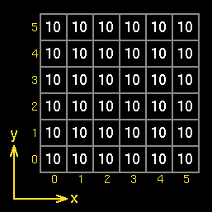
For example, with a z buffer with a range of 0 (at the screen) to 10 (at the far clipping plane), and a 6x6 pixel image.
For simplicity, all vertices of a polygon are at the same depth:
Initialise: Set all z values to maximum

Slide 14
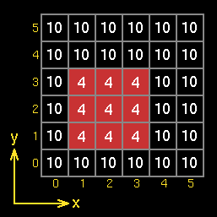
Render polygons: Polygon 1: Depth=4; vertex1=(1,1); vertex2=(1,3); vertex3=(3,3); vertex4=(3,1) This polygon is rendered entirely as there is nothing to obscure it.

Slide 15
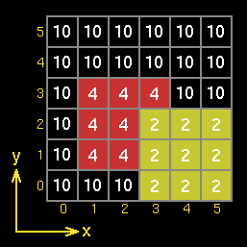
Polygon 2: Depth=2; vertex1=(3,0); vertex1=(3,2); vertex1=(5,2); vertex1=(5,0) This polygon is nearer to the viewer than the red one, so it is drawn completely.

Slide 16
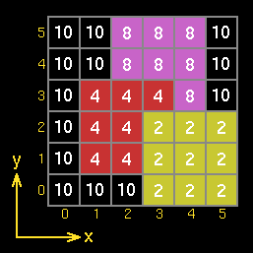
Polygon 3: Depth=8; vertex1=(2,2); vertex2=(2,5); vertex3=(4,5); vertex4=(4,2) This polygon has a larger depth value than the red and yellow ones, so the z buffer does not allow part of it to be drawn.

Slide 17
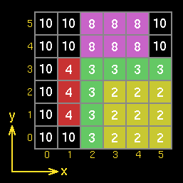
Polygon 4: Depth=4; vertex1=(2,0); vertex2=(2,3); vertex3=(5,3); vertex4=(5,0) This polygon is drawn between over the red and purple polygons, but is obscured by the yellow polygon.

Slide 18
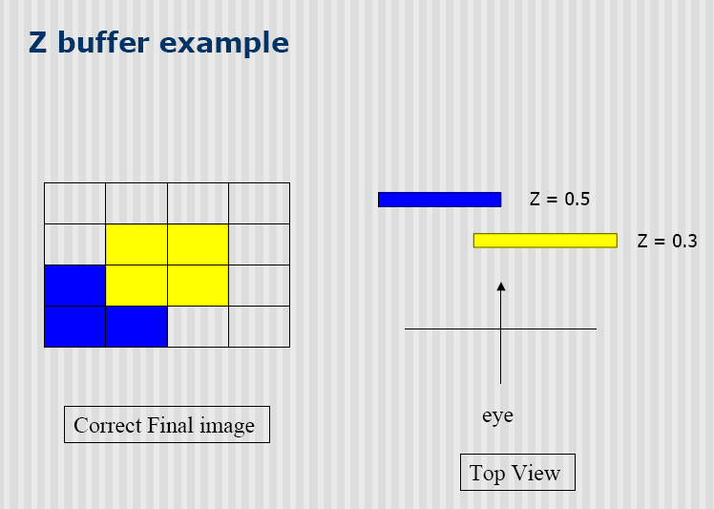
Notes:
‹#›

Slide 19
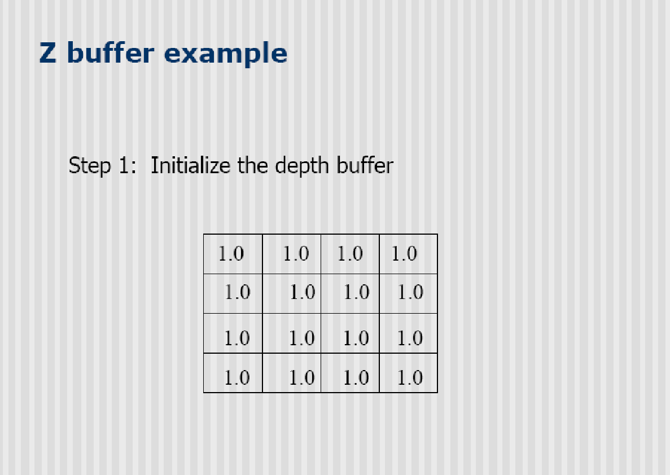
Notes:
‹#›

Slide 20
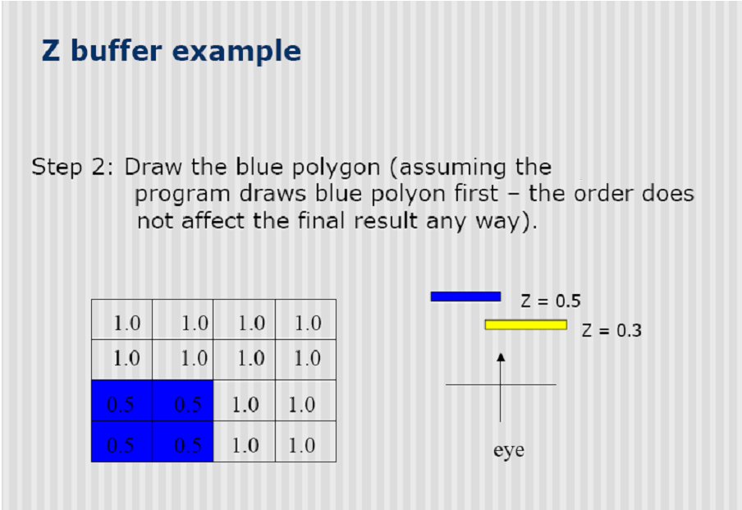
Notes:
‹#›

Slide 21
Depth-Buffer (Z-Buffer)
Advantages/Disadvantages
Lots of memory
Linear performance
Polygons may be processed in any order
Modifications needed to implement antialiasing, transparency, translucency effects
Commonly implemented in hardware ⇒ very fast
Notes:
‹#›

Slide 22
Characteristics
Extension of the scan-line algorithm for filling polygon interiors
For all polygons intersecting each scan line
Processed from left to right
Depth calculations for each overlapping surface
The intensity of the nearest position is entered into the refresh buffer

Slide 23

Depth-Sorting Algorithm
This method performs the following basic functions:
Surfaces are sorted in order of decreasing order.
Surfaces are scan converted in order, starting with the surface of greatest.

Slide 24
Algorithm
Referred to as the painter’s algorithm
In creating an oil painting
First paints the background colors
The most distant objects are added
Then the nearer objects, and so forth
Finally, the foregrounds are painted over all objects
Each layer of paint covers up the previous layer
Process
Sort surfaces according to their distance from the viewplane
The intensities for the farthest surface are then entered into the refresh buffer
Taking each succeeding surface in decreasing depth order

Slide 25
Depth-Sorting Algorithm
Simple approach: render the polygons from back to front, “painting over” previous polygons:

Slide 26
Depth-Sorting Algorithm

Slide 27
Depth-Sorting Algorithm

Slide 28
Painter’s Algorithm: Problems
Intersecting polygons present a problem
Even non-intersecting polygons can form a cycle with no valid visibility order:

Slide 29
Operations
Image-space and object-space operations
Sorting operations in both image and object-space
The scan conversion of polygon surfaces in image-space
Basic functions
Surfaces are sorted in order of decreasing depth
Surfaces are scan-converted in order, starting with the surface of greatest depth

Slide 30
Painter’s Algorithm
Pros:
No extra memory
Relatively fast
Easy to understand and implement
Cons:
Precision issues (and additional work to handle them)
Sort stage
Intersecting objects

Slide 31
Drawback
If two or more surfaces alternately obscure each other
Infinite loop
Flag any surface that has been reordered to a farther depth
It can’t be moved again
If an attempt to switch the surface a second time
Divide it into two parts to eliminate the cyclic loop
The original surface is then replaced by the two new surfaces

Slide 32
Thank You

